Slide 1
Damages

Slide 2
Acknowledgement
The images/ video clips in the presentation are drawn from different internet sites for the purposes of classroom instruction.
The references to the sources are at the end of the presentation.

Slide 3
Breach and damages
go together.

Slide 4
For every breach of
a term of a contract,
the suffering party has
a right to claim damages.

Slide 5
Examples

Slide 6
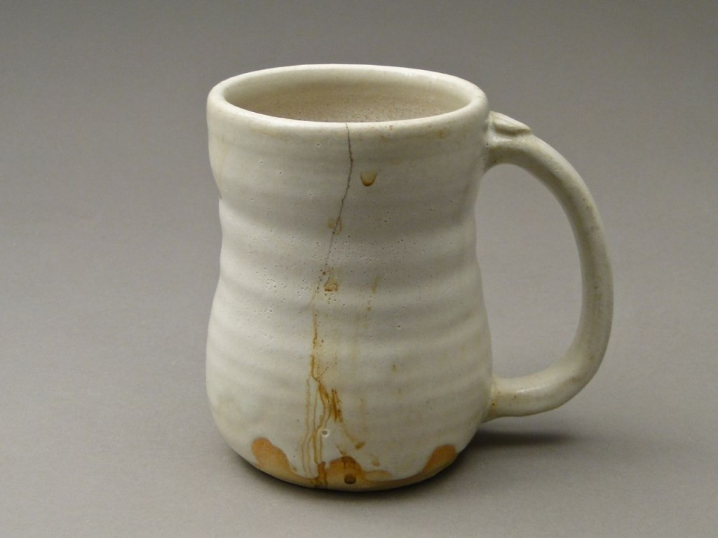
Seller delivering defective goods

Slide 7
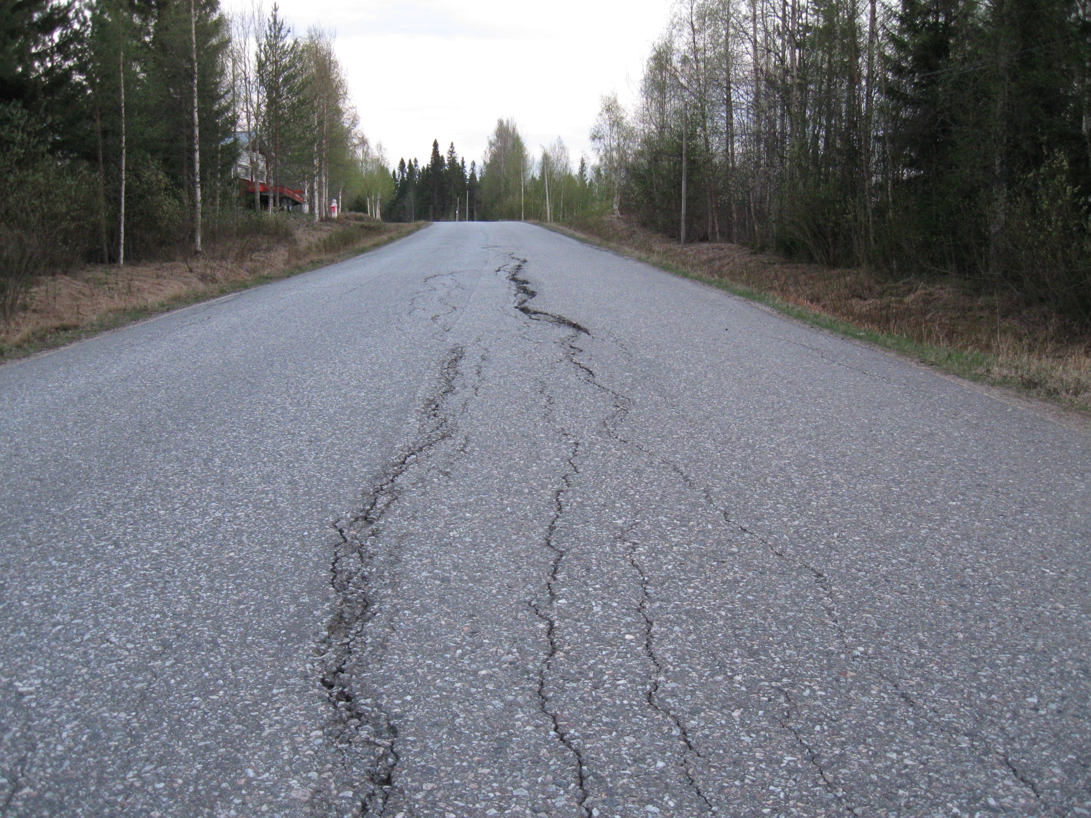
Poor construction

Slide 8

Cancelled Flight

Slide 9
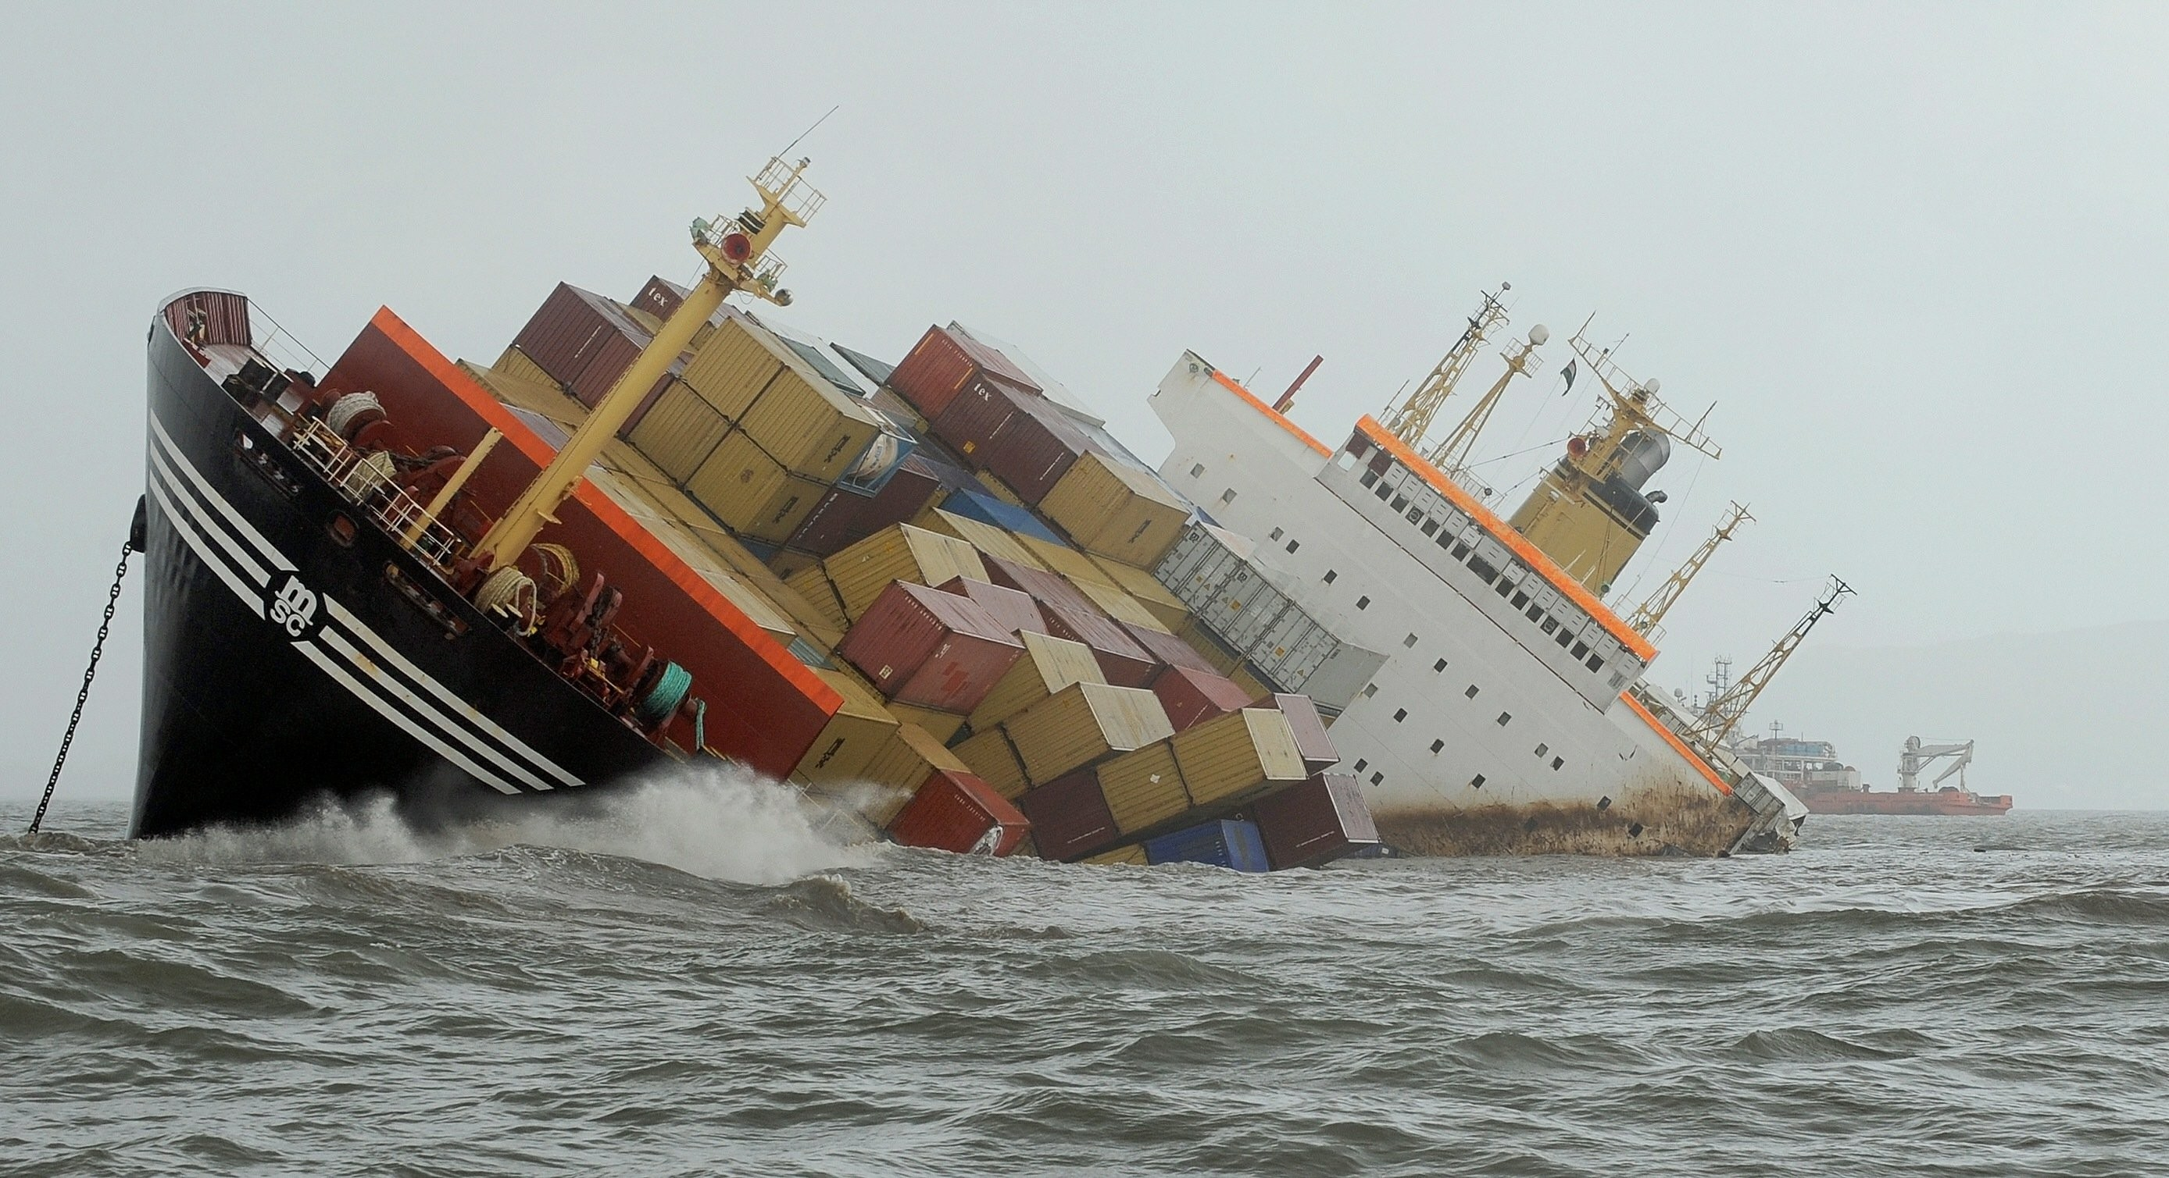
Lost cargo

Slide 10
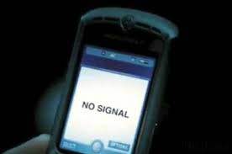

Slide 11

Payment default

Slide 12
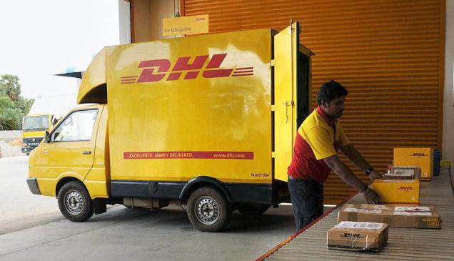
Delayed courier

Slide 13
For every breach,
damages can be claimed.

Slide 14
Principles of
award of damages.

Slide 15
Specific performance:
made to do
the contractual duty.

Slide 16
Specific performance:
awarded only in contracts on
immovable property.

Slide 17
What are
immovable properties?

Slide 18

Land

Slide 19

Soil, rock and boulders

Slide 20
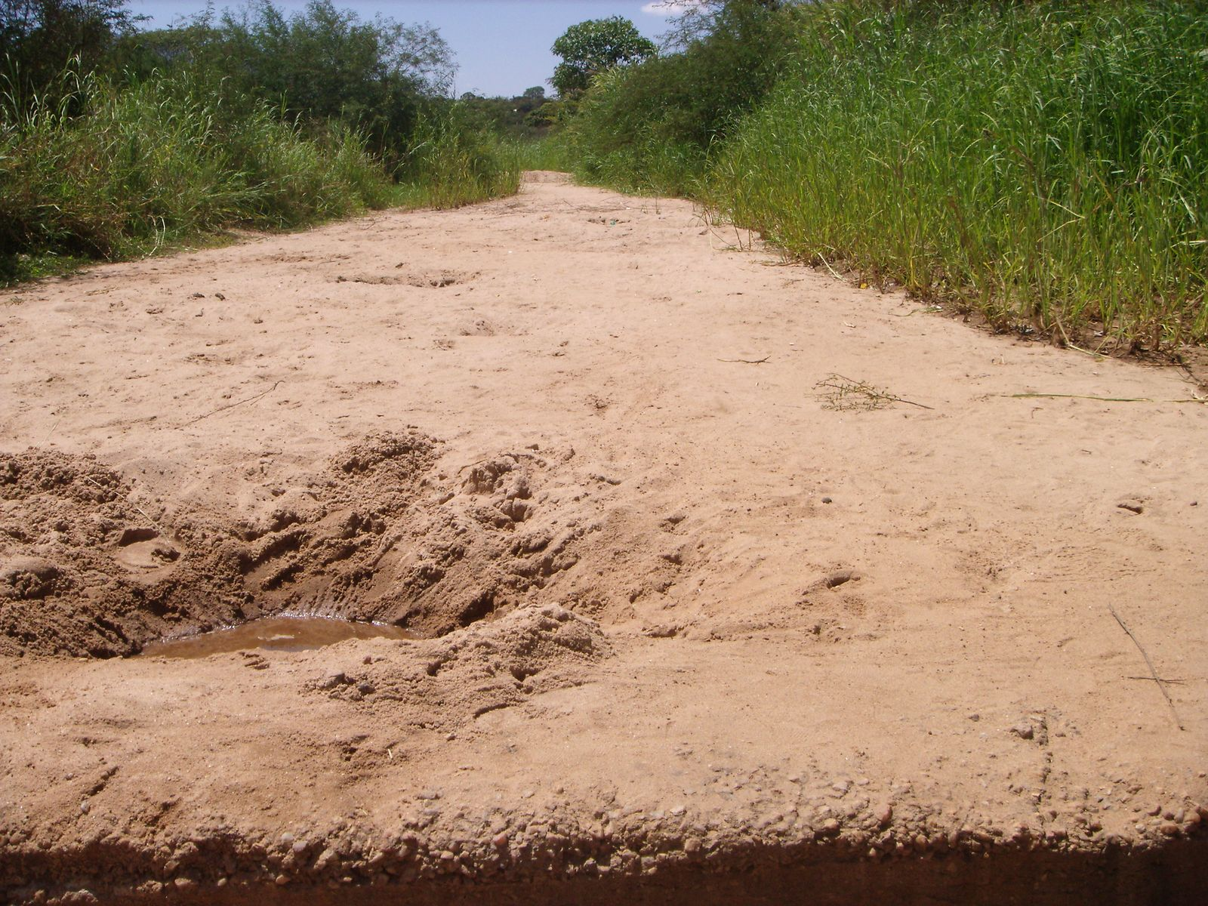
Sand

Slide 21

Lake, ponds and rivers

Slide 22
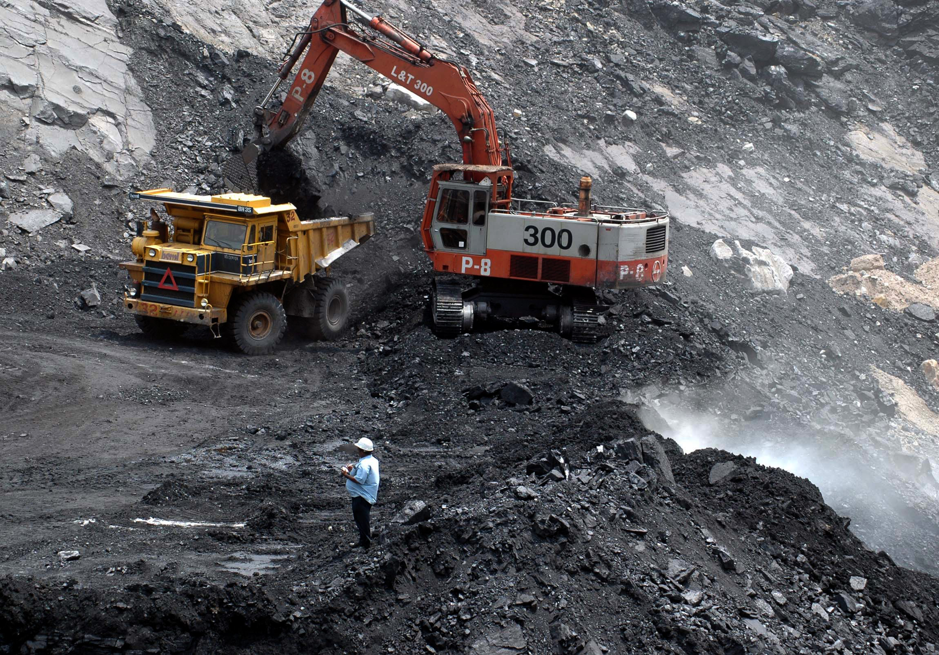
Mines and minerals

Slide 23
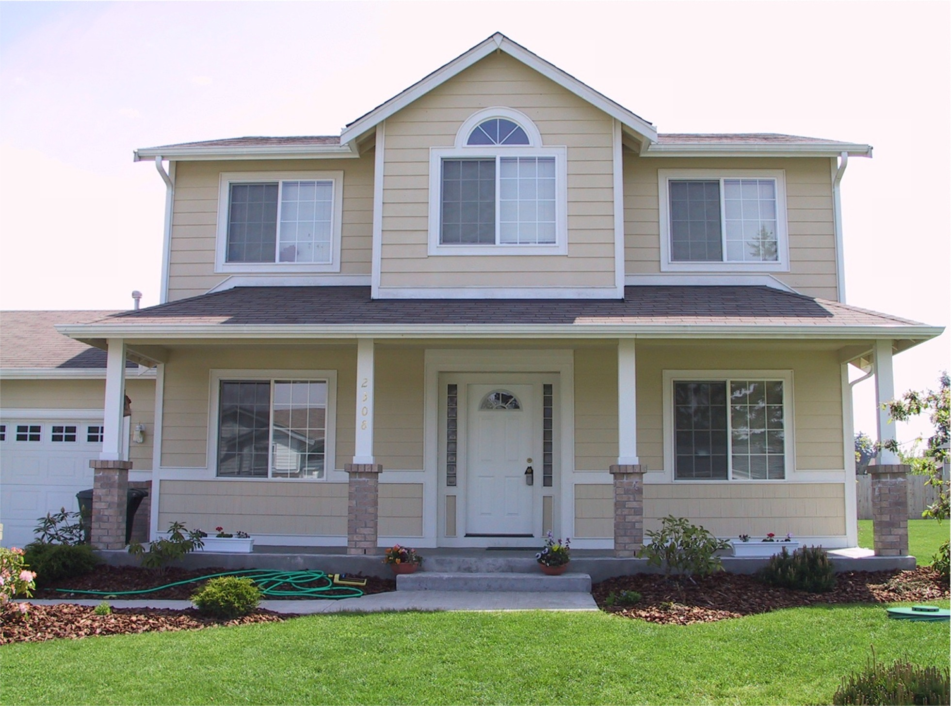
House

Slide 24
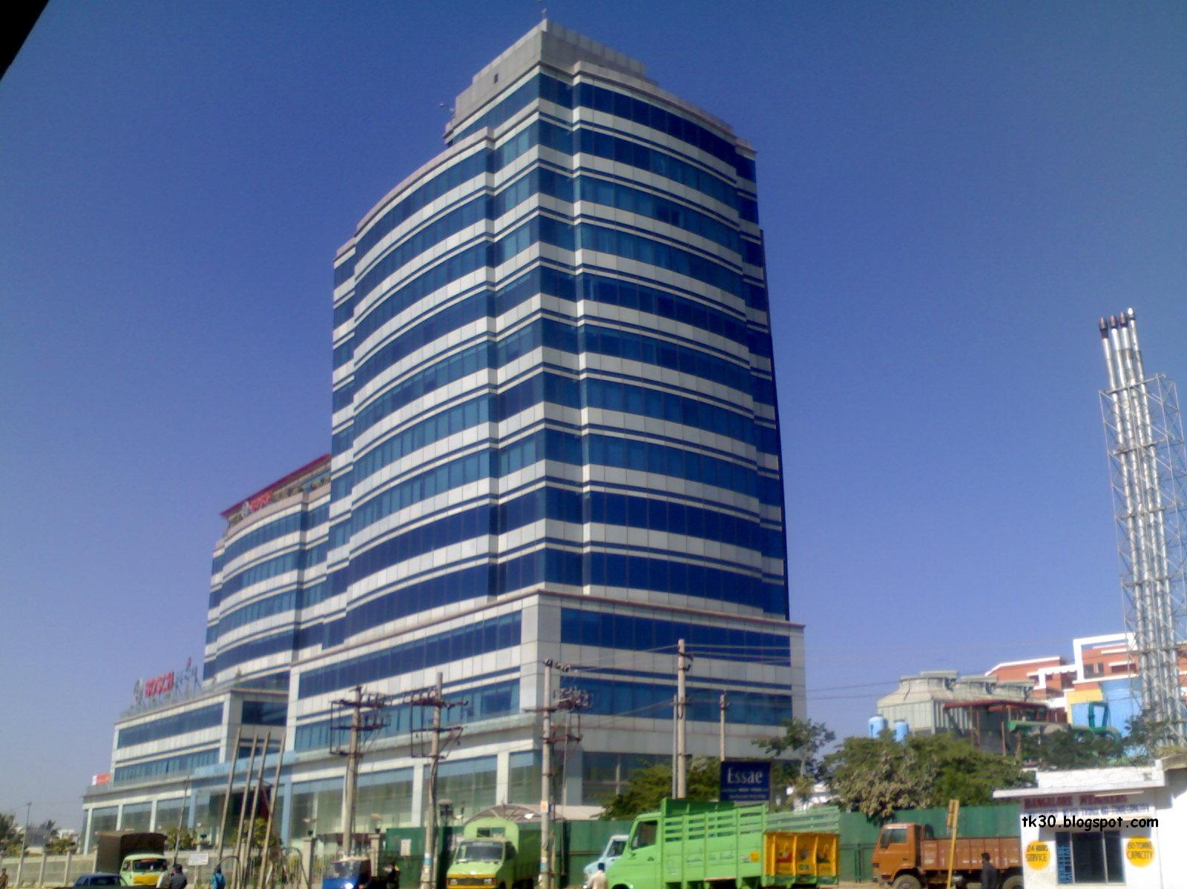
Building

Slide 25
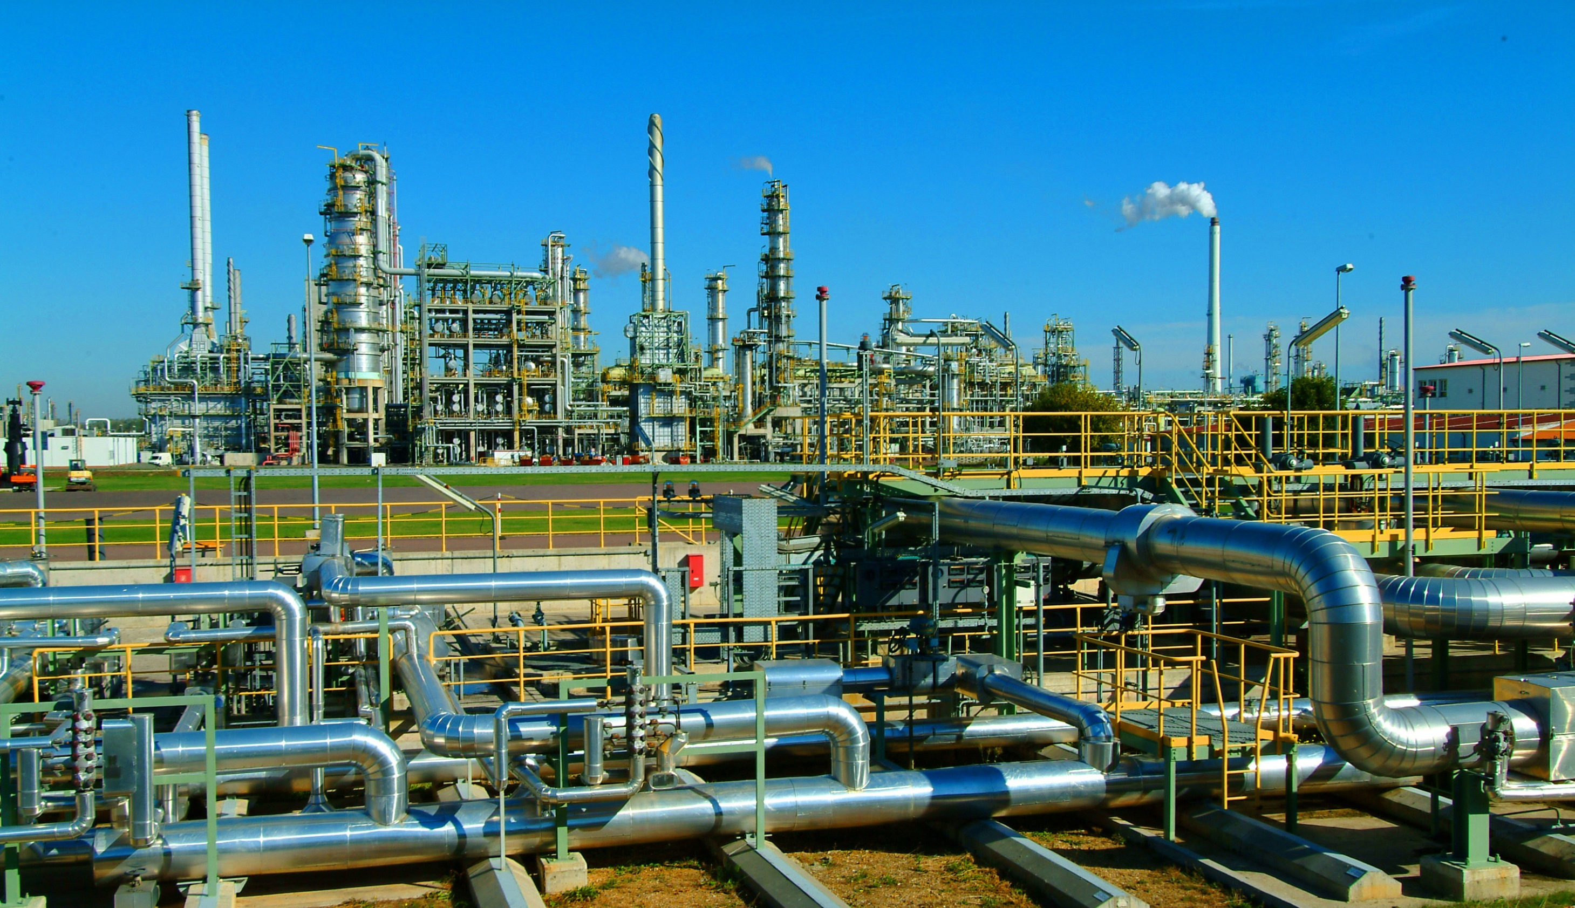
Factory

Slide 26

Bridge

Slide 27
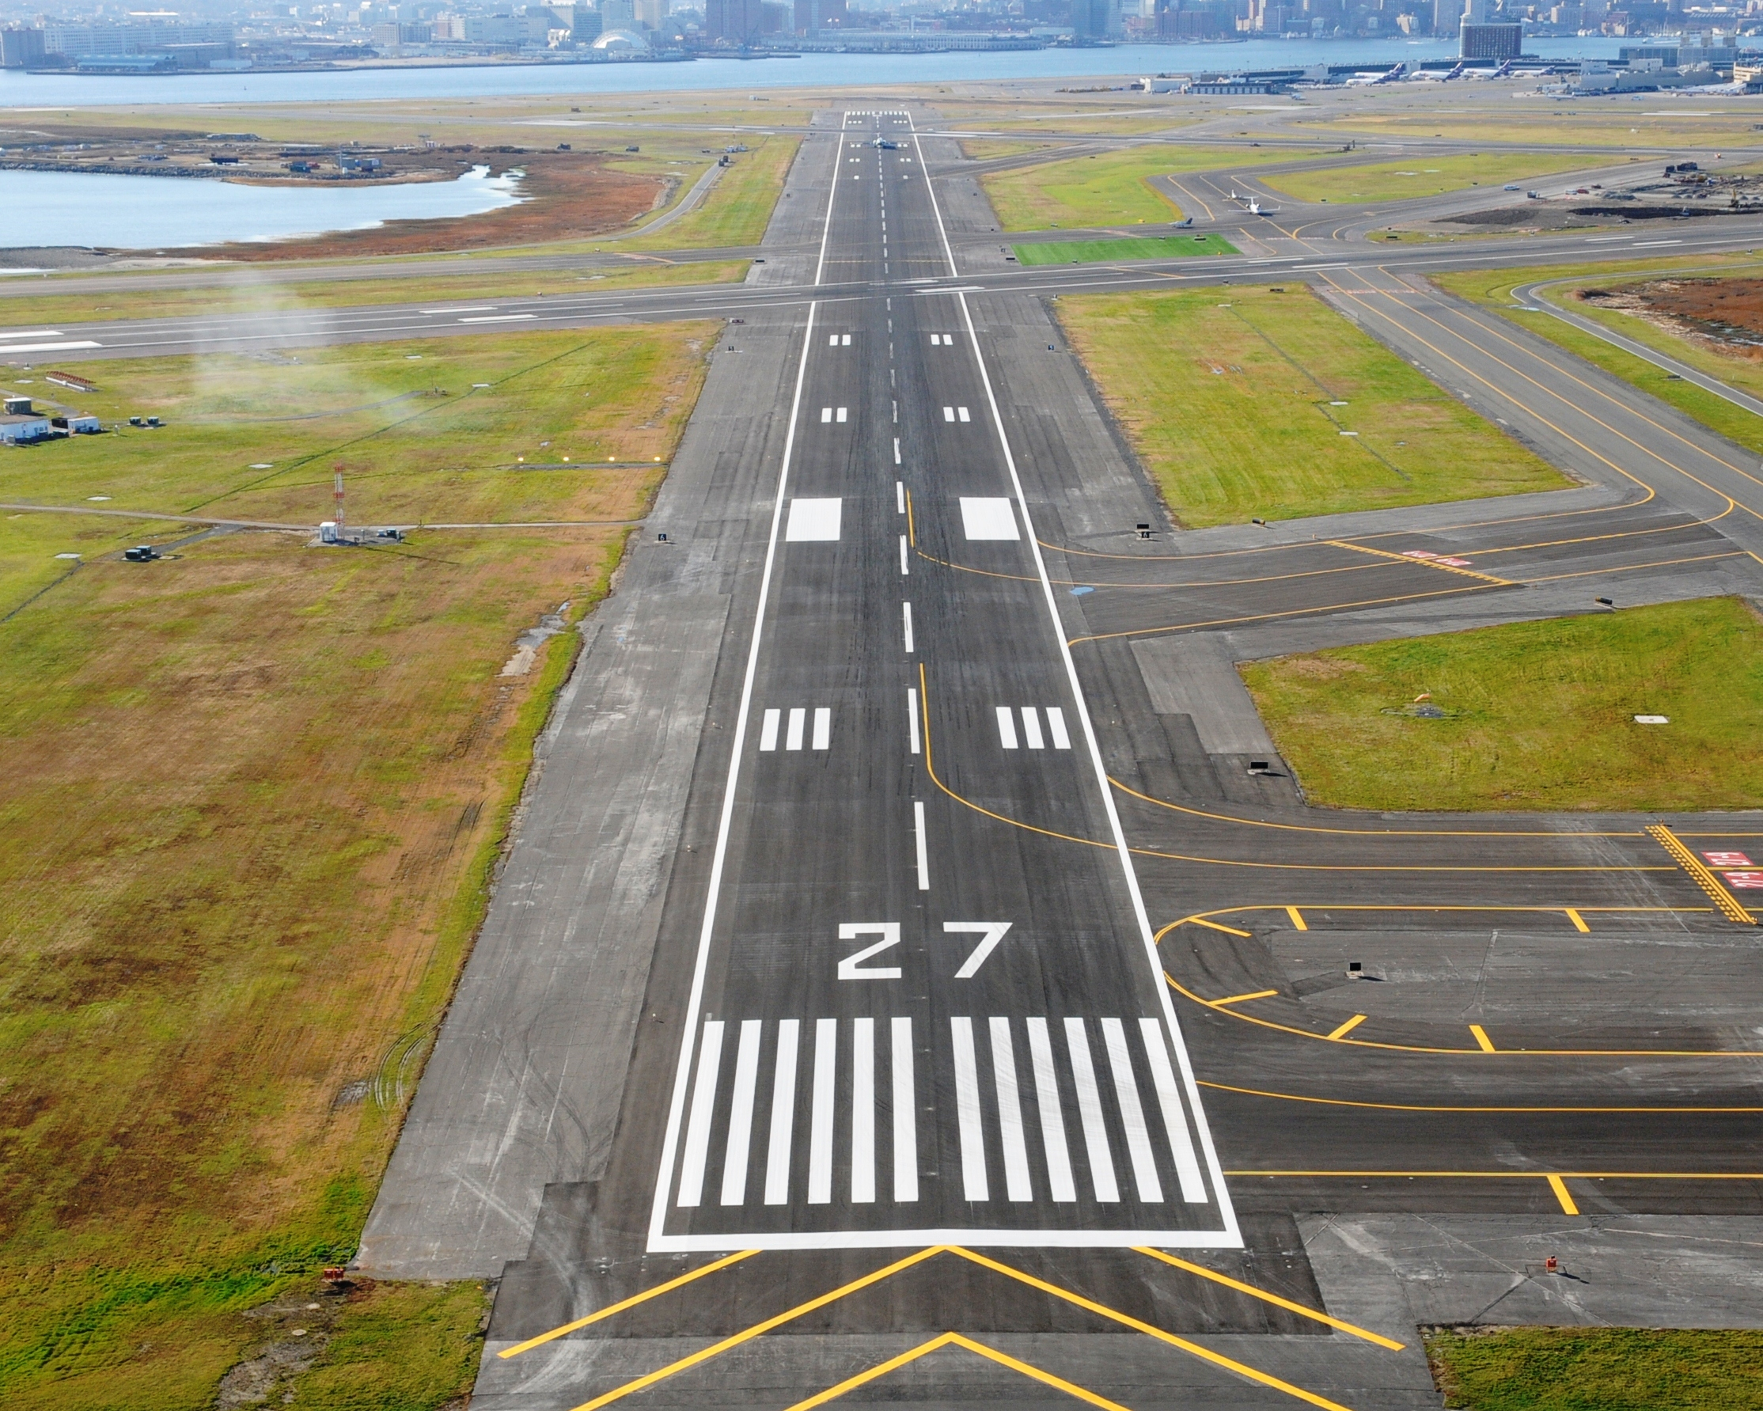
Runway

Slide 28
What are the contracts
on immovable property?
Sale, lease and mortgage

Slide 29
In all other contracts,
losses are covered by money.

Slide 30

Pebble is the breach.
Ripples,
the consequences.

Slide 31
Every breach has consequences
As far as the parties intend to go. It is their contract.
But most contracts were silent on consequences.
How for do we go in awarding damages?

Slide 32
The courts found it complex to imply consequences. The judgements were lengthy and philosophical.

Slide 33
Businesses readily learnt
to provide on consequences.

Slide 34
Most contracts provide:
There will be no liabilities for consequential losses
or indirect losses.

Slide 35
Recall:
Courier case from session 2-3. This case introduced us to signed written contracts.

Slide 36
Courier Case: Contract Terms
1. The sender must mention the complete postal address with pincode. In addition, the telephone number of the receiver must be mentioned.
2. In the case of a consignment which is not a document, the sender will provide the description of the goods and its value.
3. The following articles will not be accepted for carriage:
4. City Express will not provide any insurance coverage for any consignments sent, even if the value of the consignment is declared by the sender or required to be declared by City Express.
5. …City Express will not be responsible for any consequential losses.
6. No compensation or refund will be paid due to late delivery of this consignment”.
7. Queries on consignment should be raised within 30 days from the date dispatch of consignment.
8. Octroi, or any other tax or duty levied on the consignment shall be born by the consignor/consignee. The amount would need to be paid by the consignor/consignee immediately on demand.
9. The sender will be entirely responsible for civil and criminal consequences arising from consigning or attempting to consign any prohibited item listed under clause 3.
10. Any dispute, controversy or claim arising out of or relating to the contract shall be subject to the jurisdiction of Courts of Mumbai.

Slide 37
What then is
a direct loss?

Slide 38
Recall:
Contract law had developed
with traders, buying and selling goods for money and profit.

Slide 39
Principle for damages
Money to put the parties
in a position, as if
the contract were not breached.

Slide 40
Money to make it as good
as if the contract were performed.

Slide 41
Seller in breach:
The buyer could buy in the market
and claim the difference
as damages.

Slide 42
Buyer in breach:
The seller could sell in the market
and claim the difference
as damages.
Lost a customer and could
claim loss of profit.

Slide 43
Mitigation of losses
The party suffering breach
should act prudently
and mitigate the losses.

Slide 44
Exercise
Damages: Sale Contracts: Breach by Seller

Slide 45
1. Seller fails to deliver TV contracted for Rs. 55,000. Market price Rs. 60,000
The buy has to spend more for the same thing.
The price difference is the damages.
Rs. 5000
51(3): ‘Available market … damages is prima facie to be ascertained by the difference between the contract price and the market price.’

Slide 46
2. Seller fails to deliver laptops contracted for Rs. 30,000 a piece. Market price Rs. 28,000.
Nil
There is no loss.

Slide 47
3. Seller delivers defective stabiliser. Contract price Rs. 35 lakhs. Market price Rs. 35.6 lakhs. The buyer did not buy it.
Should Rs. 60, 000 be awarded in damages?
51(3): ‘Available market … damages is prima facie to be ascertained by the difference between the contract price and the market price.’
Yes

Slide 48
4. Seller failed to deliver truck. The buyer buys from another source for Rs. 25,000 more. Incurs further Rs. 4000 is finding another seller.
Should Rs. 25, 000 be awarded in damages?
Should the additional Rs. 4000 be awarded?
51(3): ‘Available market … damages is prima facie to be ascertained by the difference between the contract price and the market price.’
Yes
No

Slide 49
Exercise
Damages: Sale Contracts:
Breach by Buyer
Correction: Top para, line 4. Change ‘buyer’ to ‘seller’

Slide 50
1. Painting auctioned for Rs. 50 lakhs. The buyer breaches and the painting is re-auctioned for Rs. 48 lakhs.
The painting is a specific particular thing.
The seller has lost Rs. 2 lakhs.
The price difference becomes the damages.

Slide 51
Questions 2 and 3
Rs. 7000
Rs. 7000
For every breach, damages are to be awarded.
The seller has lost a customer and with it, the profit. This is the damages.

Slide 52
4. The buyer breaches soon on formation of the contract.
Is the buyer in breach?
Then, he must pay damages.
What has the seller lost?
Loss of profit for the seller:
Yes
A customer
Rs. 10,000

Slide 53
Exercise
Damages: Service Contracts

Slide 54
Question 1
The contract is performed for one month.
Period remaining- 5 months.
Going rate: Rs. 35,000 Losses:
5 x Rs. 5,000 =
Rs. 25,000

Slide 55
Question 2: The 100 Km road building project abandoned after completing 60 Kms.
How should the employer go forward?
Find another contractor to resume and complete the project.
Project value realized:
Project value remaining:
Value of second contract: Say, Rs. 350 Crores
Damages: 350 – 320= 30 crores
(800/100)*60= 480 Cr
(800/100)*40 = 320 Cr

Slide 56
Question 3
Rs. 400. Loss of profit.
Question 4: Nil
Question 5: Nil
Question 6: Rs. 8000 (minus minor fuel savings in going a passenger less.)

Slide 57
Exercise
Damages: Construction Contracts

Slide 58
Question 1
Pay damages to rebuild the house.

Slide 59
Question 2
Pay damages to rebuild the pool.

Slide 60
Question 3
Pay damages to rebuild the pool.

Slide 61
Ruxley Presentation

Slide 62
Question 1
Revisited after Ruxley Presentation
Pay damages to rebuild the house.
Damages for the lowered aesthetics.

Slide 63
Question 2
Revisited after Ruxley Presentation
Pay damages to rebuild the pool.
Damages only for the lowered enjoyment.

Slide 64
Question 3
Revisited after Ruxley Presentation
Pay damages to rebuild the pool.
No change

Slide 65
Liquidated Damages

Slide 66

Liquid is cash

Slide 67
Damages mentioned in money amount is Liquidated damages

Slide 68
Example
The seller will pay Rs. 5000
for each day’s of delay
in delivery of the goods.

Slide 69
Awarding the LD would leave
the strong and powerful to
impose penalty on the others.

Slide 70
But only the state
can penalise others
not private individuals.

Slide 71
Therefore, actual losses
and not LD should be awarded.

Slide 72
But LD brings certainty and
facilitates contracting businesses.

Slide 73
Balancing by the courts:
If the LD appears to be a
‘genuine pre-estimate’ of loses, allow it without further questions.

Slide 74
if LD is not
a genuine pre-estate of losses, assess the actual losses
and award it.

Slide 75
Liquidated Damages
Appears to be a genuine pre-estimate of losses
Does not appear to be a genuine pre-estimate of losses.
Award the LD
Assess the actual losses and award it.

Slide 76
Damages Clauses
Damages clause in a contract covers:
Limit consequential and indirect losses
Provide, specify and qualify award of loss of profit/ loss of profit
Liquidated damages is provided for delays.

Slide 77
Exercise
Damages: Contract Terms

Slide 78
Question 1
Delay: 2 weeks. Consequential losses: Rs. 2 lakhs. Hiring of batteries for Rs. 5000.
Damages to be awarded-
Hiring charges: Rs. 5000
LD for 2 weeks = Rs. 4 lakhs x 0.5% x 2 weeks =
Rs. 4000
No production losses: ‘Limitation of Liability- Neither party shall be liable …loss of profits or loss of production.

Slide 79
Question 2
The seller breached in delivery and the buyer bought from another source for Rs. 50,000 more than the contract price. Delay of 3 days in getting alternate batteries. Consequential losses: Rs. 3 lakhs
Damages: Price difference- Rs. 50,000
No LD as it is only for ‘delay in delivery’. There is no delivery in this case.
Consequential losses not allowed.

Slide 80
Question 3
The seller delayed by four weeks and then the buyer terminated the contract. The buyer hired for Rs. 10,000 and purchased for Rs. 60,000 above the contract price.
Hire Charged: Rs. 10,000
Price difference- Rs. 60,000
No LD as it is only for ‘delay in delivery’. There is no delivery in this case.
Total damages: Rs. 70,000

Slide 81
Question 4
The seller was to deliver ten laptops at Rs. 30,000 each. The seller delivered defective laptops. The buyer terminated the contract and bought laptops of the same brand and description. The buyer got it for Rs. 28,000 each. Calculate the damages the buyer can claim from the seller.
No damages will be awarded as there is no loss in buying from another source.

Slide 82
Question 5
The seller was to deliver a car to the buyer which the buyer was to re-sell at a profit of 10%. The seller failed to deliver the car. The buyer bought a car from another supplier for the same price. However, due to the delay, the buyer lost the customer and the profit. Calculate the damages the buyer can claim from the seller.
There is no price difference in buying from another source. Thus, no damages on this count.
No loss of profit: ‘Limitation of Liability- Neither party shall be liable …loss of profits or loss of production.

Slide 83
Question 6
The Battery explodes. Claim of damages:
1. Price Difference: Rs. 18,000
2. Damages to machine and
Building. Rs. 1.5 lakhs
Yes
No. Indirect and consequential damages.

Slide 84
Question 7
The vendor has met all the contractual requirements.
Only indirectly, he can be said to be in breach.

Slide 85
Question 8
The transporter is not in breach of contractual term.
Only indirectly, he can be said to be in breach.

Slide 86
Losses
Commercial
Non-commercial
Through contract terms on damages
Through indemnities

Slide 87
Case Presentation
Bunge v Nidera

